Slide 1
GCP GenAI Leader Certification
ERW – Part 1
Poorva Kulkarni
02.03.2025

Slide 2

Agenda
1
Introduction to gen AI for businesses
2
Introduction to gen AI foundations
3
Gen AI strategy
4
Core Gen AI Concept
5
Foundation models
6
Building AI securely and responsibly

Slide 3
What is generative AI?
● Gen AI is a type of artificial intelligence that helps users create new content and ideas.
● It’s a technology that can be integrated into different applications.
Example: Gemini ● Gemini app: Google’s generative AI chatbot, an app
● Gemini: One of Google’s gen AI models used to build applications Gemini app, Gemini for Google Workspace, Gemini for Looker, Gemini in BigQuery
Gemini used with services in Google Cloud to automate and troubleshoot
https://gemini.google.com/app

Slide 4
How to use Gen AI
● Create
You can:
● Write articles, emails, and social media posts.
● Create images, videos, and audio.
● Generate code in various programming languages.
● Summarize
You can:
● Summarize long documents or articles.
● Create concise reports from complex data.
● Extract key takeaways from meetings or presentations.
● Discover
You can:
● Uncover hidden patterns and insights in data.
● Search for resources or documents.
● Monitor real-time events.

Slide 5
How to use Gen AI
● Automate
You can:
● Automate format conversation.
● Automate documentation.
● Automate notifications and alarms.

Slide 6
What is Multimodal generative AI?
Multimodal generative AI enables the simultaneous processing and creation of content across multiple types of data or “modalities.
Example:
● Text and image
● Text and a PDF file
● Text, video, and data
● Sensor data and video

Slide 7
What is Vertex AI?
Vertex AI is the key to creating and deploying custom generative AI solutions for your business.
● Vertex AI is Google Cloud's unified AI development platform.
● It empowers you to build, train, and deploy ML models and AI applications.
● It gives you access to Google's large generative AI models through Model Garden.
● It allows you to tune Google's LLMs to meet your needs and deploy them for use in
your AI-powered applications.

Slide 8
Introduction to gen AI foundations
Foundation Models
Traditional AI models
Trained for a single purpose using specific data.
Example: Filtering spam emails from your inbox.
Foundation AI models
Trained on massive amounts of diverse data (text, images, and code), enabling them to adapt to many different tasks.
Examples: Large language models (LLMs), Imagen, Chirp

Slide 9
Example of foundation models
Gemini
They are trained on a massive dataset of text, images, code, audio, video, etc. Multimodal training allows them to perform tasks across various domains
Imagen
Trained on a massive dataset of images and text descriptions, they generate high-quality images from text descriptions, edit, and understand image content.
Chirp
Trained on a large dataset of audio in various languages, they are designed for speech recognition.

Slide 10
Introduction to gen AI foundations
Prompting Models
Foundation models, like other AI models, take in inputs, which are called prompts, to produce outputs.
Prompting is one of the most important skills in maximizing the value of gen AI models and tools.
How Prompting works ?
Prompt (input) Output
Question The answer to the question
Request for an image based on a text description The image
Request a summary of a file The file summary
Sample code with errors Corrected code with no errors

Slide 11
Gen AI Strategies
Multi-directional strategy: Top-down and bottom-up
Combine high-level strategic planning (top-down) with practical input from teams who will use the technology (bottom-up).
Multi-directional strategy: Top-down
● Create a clear and compelling vision for AI by aligning AI solutions with your strategic business priorities.
● Identify the most important use cases and workflows.
● Then, consider how AI can support you in those priorities.
Multi-directional strategy: Bottom-up
● Encourage teams to share their challenges and ideas for gen AI solutions.
● Encourage employees to use gen AI at a small scale. Then share their solutions for broader implementation.

Slide 12
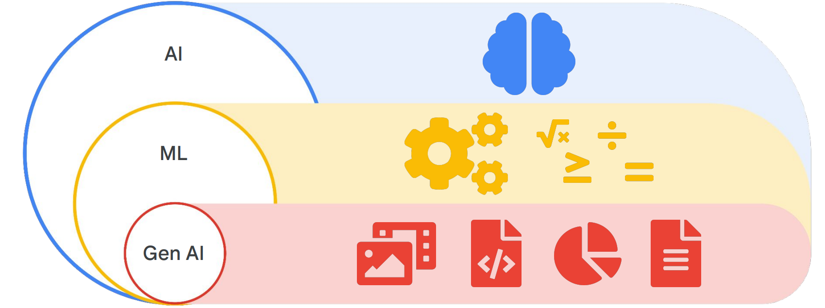
Core Gen AI Concept
Understanding AI, ML, and gen AI
Defining AI, ML and gen AI
AI : Building or creating machines to do tasks that normally require human intelligence.
ML : A subset of AI where machines learn from data to perform specific tasks. Different data creates different models.
AI : A subset of machine learning that focuses on creating new content.

Slide 13
What is Data
Data is information that can come in many forms: numbers, dates, text descriptions, and even images or sounds.
ML models analyze the data they've been given, identify patterns, and then calculate the likelihood of different outcomes when presented with new information. So, data quality and accessibility are crucial for accurate predictions.
Data types
● Structured data - Organized; easy to search for and find the information you need
● Unstructured data - Lacks a predefined structure; messy and complex, can’t be easily organized

Slide 14
Types of Learning
Machine learning has 3 primary approaches and data requirements
1. Supervised - Supervised learning trains models on labeled data to predict outputs for new inputs.
2. Unsupervised - Unsupervised learning uses unlabeled data to find natural groupings and patterns.
3. Reinforcement learning learns through interaction and feedback to maximize rewards and minimize penalties.

Slide 15
Foundation Model
Deep Learning
Generative AI uses the power of deep learning to create new content spanning text, images, audio, and beyond. Deep learning techniques, particularly those centered on neural networks, are the engine behind these generative models
Types of foundation models
Large language models (LLMs)
Diffusion models

Slide 16
Foundation Model
Google strategies for foundation model limitations
To overcome the limitations of foundation models like Data dependency, Knowledge cut-off, Bias, Hallucinations, below techniques are used
Prompt engineering
Grounding
Retrieval-Augmented Generation (RAG)
Fine-tuning

Slide 17
Building AI securely and responsibly
Protecting your AI applications from harm. Ensuring your AI applications don’t cause harm and are used in an ethical manner.
The Secure AI Framework (SAIF) establishes security standards for building and deploying AI systems responsibly
Google Cloud enables secure development with its secure-by-design infrastructure, encryption, IAM, Security Command Center, and tools for monitoring, for comprehensive security.

Slide 18
Happy Preparations & All the Best ..!!
Thank You!

